Slide 1
Insertion, Updation, and Deletion Anomalies
(A Guide to Database Anomalies with Examples)

Slide 2
Introduction to Anomalies
- Anomalies occur due to improper database design.
- Three types of anomalies: Insertion, Updation, and Deletion.
- Normalization helps in reducing anomalies.

Slide 3
How are Anomalies Caused in DBMS?
What exactly does “bad construction” imply? When the DB (database) designer constructs the database, he should identify the entities that rely on one other for existence, such as hotel rooms and the hotel, and then reduce the probability that one might ever exist independently of the other.
A database anomaly is a fault in a database that usually emerges as a result of inappropriate planning and storing everything in a flat database. In most cases, this is removed through the normalization procedure, which involves the joining and splitting of tables. The purpose of the normalization process is to minimize the negative impacts of generating tables that would generate anomalies in the DB

Slide 4
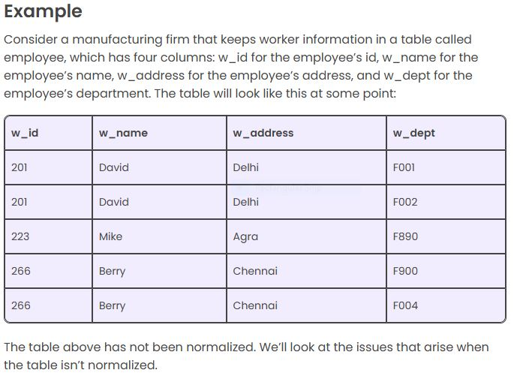

Slide 5
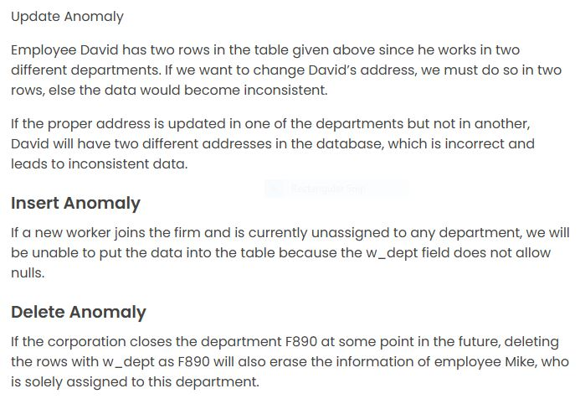
Example-

Slide 6
Insertion Anomaly
- Occurs when adding new data is difficult without unnecessary details.
- Example: A database storing student and course details together.
- If a new course is introduced but no student enrolls, we cannot insert the course details.

Slide 7
Example: Insertion Anomaly
Student_ID | Student_Name | Course_ID | Course_Name |
|------------|--------------|------------|--------------|
| 101 | Alice | CSE101 | DBMS |
| 102 | Bob | CSE102 | OS |
Cannot insert a new course if no students are enrolled.

Slide 8
Update Anomaly
Occurs when modifying data in multiple places leads to inconsistency.
Example: If a professor’s name changes, we must update it in multiple rows.

Slide 9
Example: Update Anomaly
| Prof_ID | Prof_Name | Course_ID | Course_Name |
|---------|----------|------------|--------------|
| 1 | Dr. Smith | CSE101 | DBMS |
| 1 | Dr. Smith | CSE102 | OS |
- If Dr. Smith's name changes, we must update all records.

Slide 10
Deletion Anomaly
- Occurs when deleting a record removes useful data.
- Example: If the only student enrolled in a course is removed, course details are also lost.

Slide 11
Example: Deletion Anomaly
| Student_ID | Student_Name | Course_ID | Course_Name |
|------------|--------------|------------|--------------|
| 101 | Alice | CSE101 | DBMS |
- If Alice is removed, course CSE101 details are lost.

Slide 12
Solution – Normalization
- Normalization divides data into smaller tables to eliminate redundancy.
- Example: Splitting into separate Student and Course tables prevents anomalies.

Slide 13
Summary of Anomalies
1. **Insertion Anomaly:** Cannot add data without unrelated details.
2. **Update Anomaly:** Multiple updates needed for consistency.
3. **Deletion Anomaly:** Losing data when removing records.
✅ **Solution:** Apply database normalization.

Slide 14
Thank You!
- Any questions? 😊
- Happy Learning! 🚀

Slide 15
Closure of an Attribute Set-
The set of all those attributes which can be functionally determined from an attribute set is called as a closure of that attribute set.
Closure of attribute set {X} is denoted as {X}⁺.
Steps to Find Closure of an Attribute Set-
Following steps are followed to find the closure of an attribute set-

Slide 16
Step-01:
Add the attributes contained in the attribute set for which closure is being calculated to the result set.
Step-02:
Recursively add the attributes to the result set which can be functionally determined from the attributes already contained in the result set.
Example-
Consider a relation R ( A , B , C , D , E , F , G ) with the functional dependencies-
A → BC
BC → DE
D → F
CF → G
Now, let us find the closure of some attributes and attribute sets-
Closure of attribute A-
A⁺ = { A }
= { A , B , C } ( Using A → BC )
= { A , B , C , D , E } ( Using BC → DE )
= { A , B , C , D , E , F } ( Using D → F )
= { A , B , C , D , E , F , G } ( Using CF → G )
Thus,
A⁺ = { A , B , C , D , E , F , G }
Closure of attribute D-
D⁺ = { D }
= { D , F } ( Using D → F )
We can not determine any other attribute using attributes D and F contained in the result set.
Thus,
D⁺ = { D , F }
Closure of attribute set {B, C}-
{ B , C }⁺= { B , C }
= { B , C , D , E } ( Using BC → DE )
= { B , C , D , E , F } ( Using D → F )
= { B , C , D , E , F , G } ( Using CF → G )
Thus,
{ B , C }⁺ = { B , C , D , E , F , G }
Finding the Keys Using Closure-
Super Key-
If the closure result of an attribute set contains all the attributes of the relation, then that attribute set is called as a super key of that relation.
Thus, we can say-
“The closure of a super key is the entire relation schema.”
Example-
In the above example,
The closure of attribute A is the entire relation schema.
Thus, attribute A is a super key for that relation.

Slide 17
Candidate Key-
If there exists no subset of an attribute set whose closure contains all the attributes of the relation, then that attribute set is called as a candidate key of that relation.
Example-
In the above example,
No subset of attribute A contains all the attributes of the relation.
Thus, attribute A is also a candidate key for that relation.
PRACTICE PROBLEM BASED ON FINDING CLOSURE OF AN ATTRIBUTE SET-
Problem-
Consider the given functional dependencies-
AB → CD
AF → D
DE → F

Slide 18
C → G
F → E
G → A
Which of the following options is false?
(A) { CF }⁺ = { A , C , D , E , F , G }
(B) { BG }⁺ = { A , B , C , D , G }
(C) { AF }⁺ = { A , C , D , E , F , G }
(D) { AB }⁺ = { A , C , D , F ,G }
Solution-
Let us check each option one by one-
Option-(A):
{ CF }⁺ = { C , F }
= { C , F , G } ( Using C → G )
= { C , E , F , G } ( Using F → E )
= { A , C , E , E , F } ( Using G → A )
= { A , C , D , E , F , G } ( Using AF → D )
Since, our obtained result set is same as the given result set, so, it means it is correctly given.
Option-(B):
{ BG }⁺ = { B , G }
= { A , B , G } ( Using G → A )
= { A , B , C , D , G } ( Using AB → CD )
Since, our obtained result set is same as the given result set, so, it means it is correctly given.
Option-(C):
{ AF }⁺ = { A , F }
= { A , D , F } ( Using AF → D )
= { A , D , E , F } ( Using F → E )
Since, our obtained result set is different from the given result set, so,it means it is not correctly given.
Option-(D):
{ AB }⁺ = { A , B }
= { A , B , C , D } ( Using AB → CD )
= { A , B , C , D , G } ( Using C → G )
Since, our obtained result set is different from the given result set, so,it means it is not correctly given.
Thus,
Option (C) and Option (D) are correct.

